Slide 1

Mental Health Data Analysis
An Analytical Study on Global Mental Health Trends and Influencing Factors
BY : Aastha
Notes:
This report presents a comprehensive analysis of global mental health trends and the key factors influencing them. The visual depicts a stylized brain with interconnected nodes, representing the data and AI-driven insights at the core of our analysis. Surrounding the brain are subtle human silhouettes, conveying the global, human-centric nature of this mental health study. Our goal is to uncover valuable insights that can inform policies, programs, and initiatives to support mental wellbeing worldwide. I'll walk through the key findings and recommendations from this in-depth analysis.

Slide 2

Introduction
Understanding Mental Health
Mental health, encompassing emotional, psychological, and social well-being, is a critical global concern. It influences how individuals think, feel, and act, affecting stress management, relationships, and decision-making. A positive state of mental health allows individuals to realize their full potential, cope with life's stresses, work productively, and contribute meaningfully to their communities.
Despite its profound impact on individual lives and societal progress, mental health has historically been overlooked or stigmatized. However, there's a growing recognition of its integral role in overall health, productivity, and quality of life. Understanding the multifaceted nature of mental health is the first step towards developing effective strategies for prevention, intervention, and support.
According to the WHO, one in eight people globally lives with a mental disorder, highlighting the urgent need for proactive strategies and interventions.

Slide 3
Why Study Mental Health?
Overall Well-being
Early Detection
Essential for daily functioning, decision-making, relationships, and productivity.
Helps understand root causes, identify patterns, and enable early detection and intervention.
Reduce Stigma
Better Policies
Encourages more people to seek help and reduces the stigma associated with mental health conditions.
Informs healthcare policies, promotes emotional resilience, and creates inclusive environments.

Slide 4
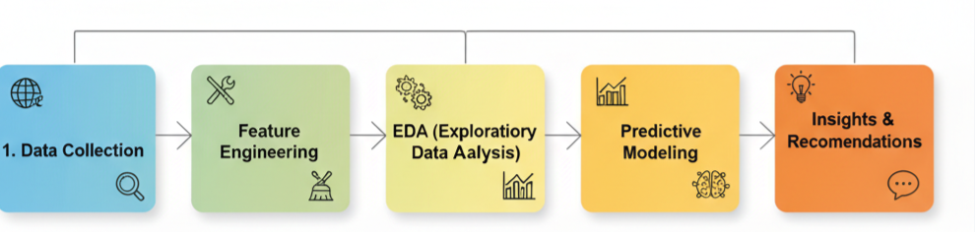
Project Goals
This project explores the relationship between mental health and socioeconomic factors using a multi-country survey dataset.
1
Uncover Patterns
2
Analyze Impact
3
Predictive Model
Assess the impact of demographic, scientific trust, and socio-economic factors on mental health status.
Build a machine learning model to predict the likelihood of mental health issues.
Input Data → Logistic Regression Model → Prediction → Evaluation
Use exploratory data analysis (EDA) to find patterns and disparities in mental health across demographics and regions.
Methodology

Slide 5
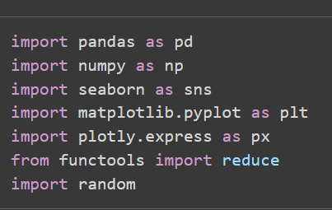
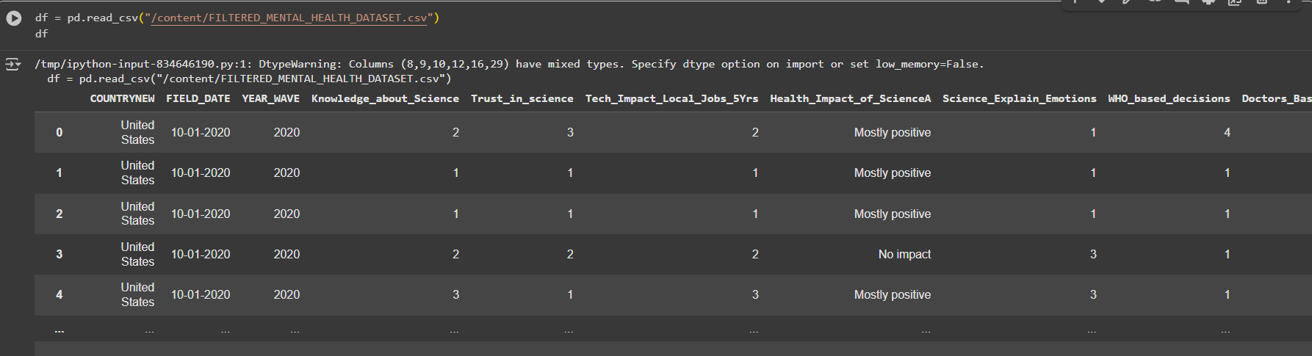
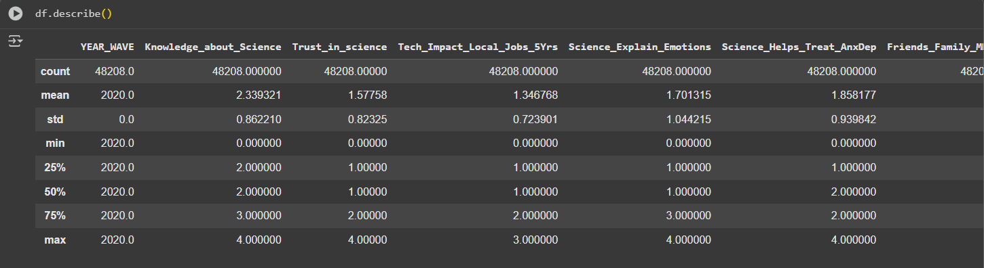
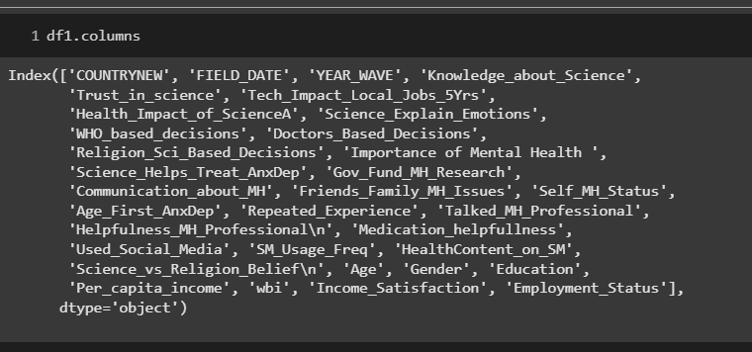
Data Preparation
Data Collection
Dataset from a large-scale international mental health survey, inspired by the 2020 Wellcome Global Monitor, with over 20,000 participants across multiple countries.
DATASET LINK : https://wellcome.org/sites/default/files/2021-11/wgm_full_wave2_public_file.zip
1. IMPORTING LIBRARIES
2. IMPORTING THE DATASET
3. UNDERSTANDING THE DATASET

Slide 6
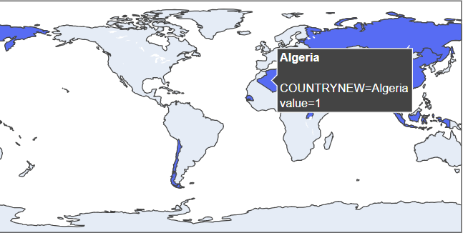
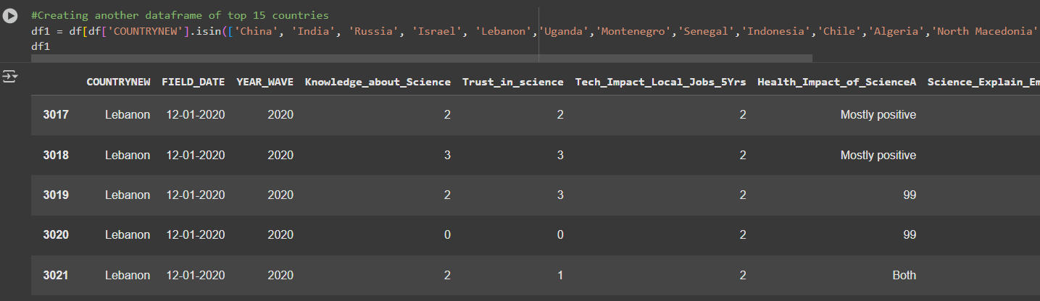

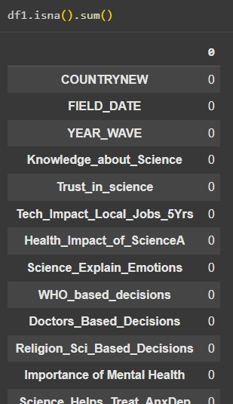
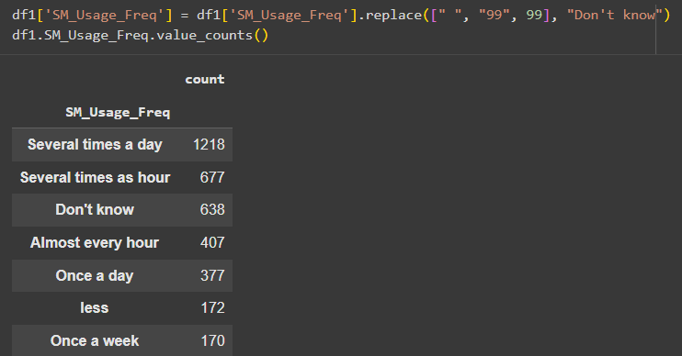
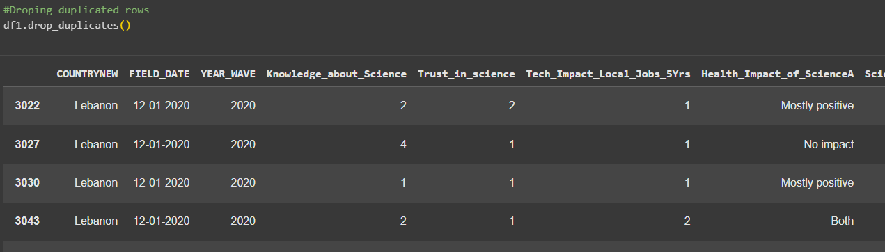
DATA CLEANING
Countries plot on map
Creating data frame of top 15 Countries
Shape of the dataset
Handling missing values
Handling duplicate values

Slide 7








Feature Engineering
Transformed raw data into meaningful features for deeper insights and model building.
Age-Based Features
Socio-Economic Groupings
Categorized age groups and analyzed age at onset of anxiety/depression.
Grouped income levels, education, and employment status to assess their impact.
Coping & Support
Psychological Attitudes
Derived features for coping mechanism effectiveness and support network strength.
Combined responses on trust in science and its influence on mental health awareness.

Slide 8
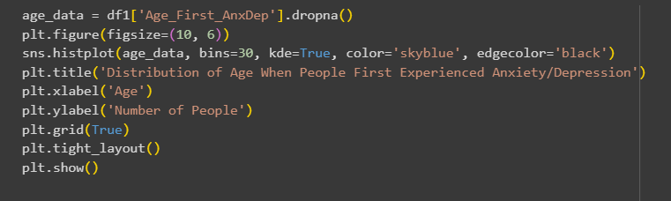

Exploratory Data Analysis (EDA)
EDA revealed key insights into the dataset's characteristics and mental health trends.
Key Findings:
China and India report the highest number of mental health cases.
Distribution of age when people first experienced anxiety or depression
Peak age for first anxiety/depression experience is around 18-20 years old.
26-35 age group shows the highest number of individuals reporting good mental health.
Higher trust in science is associated with higher percentages of good mental health.
Geographical Distribution of Survey Countries

Slide 9
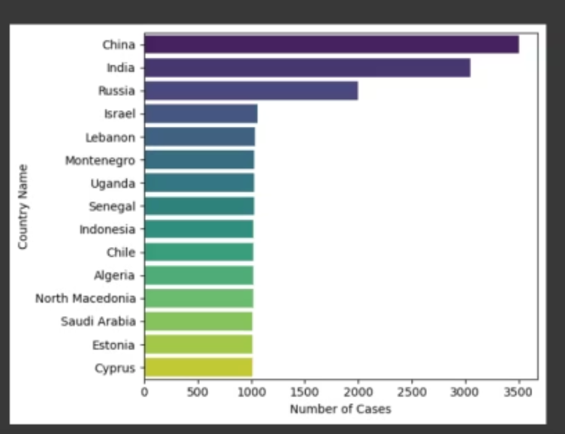
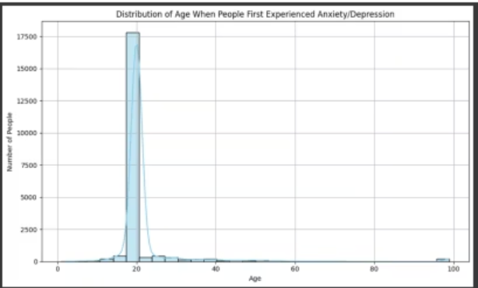
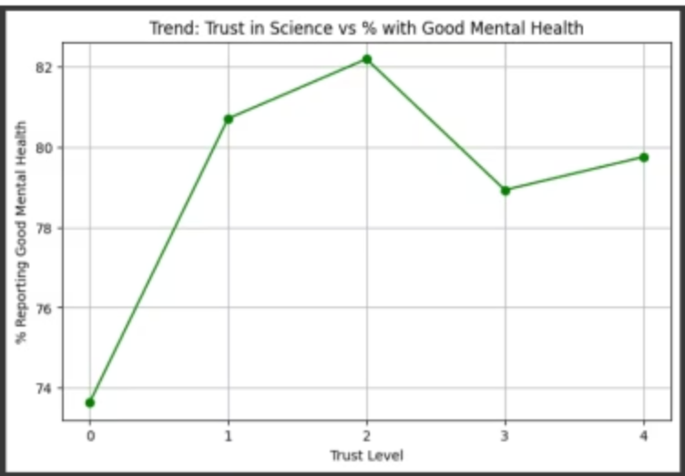
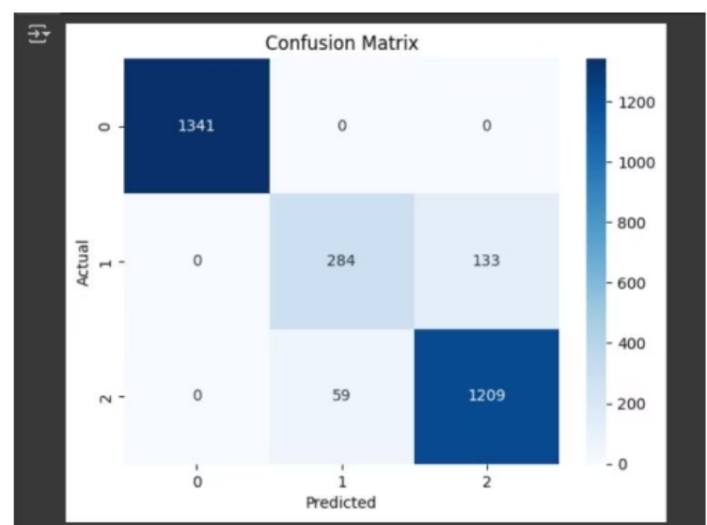
Visualizations
The peak is around 18–20 years old, with over 600 people in that bin.
Higher trust in science (Trust Levels 1 and 2) is associated with the highest percentages of people reporting good mental health—
The confusion matrix shows the model accurately predicts Class 0 and Class 2, but struggles slightly with Class 1, often confusing it with Class 2. Overall, the model demonstrates strong classification performance.
China and India report the highest number of mental health cases

Slide 10
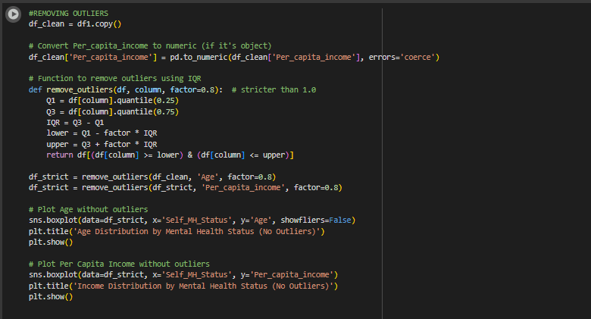
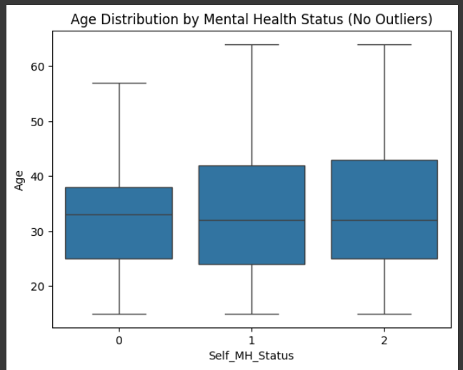
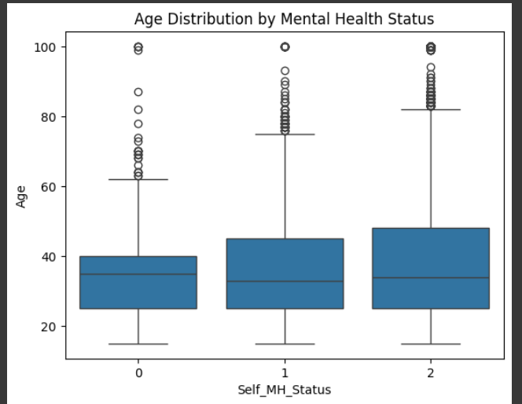
Outlier Detection
Outliers Removal
Purpose
Outliers can distort statistical summaries and affect model performance. Detecting and removing them ensures cleaner, more reliable data analysis.
Method Used
Technique: Interquartile Range (IQR) Method
Rule: Values beyond 1.5 × IQR from Q1 or Q3 are flagged as outliers.
Implementation: Python (Pandas, Matplotlib)
Detected Outliers

Slide 11
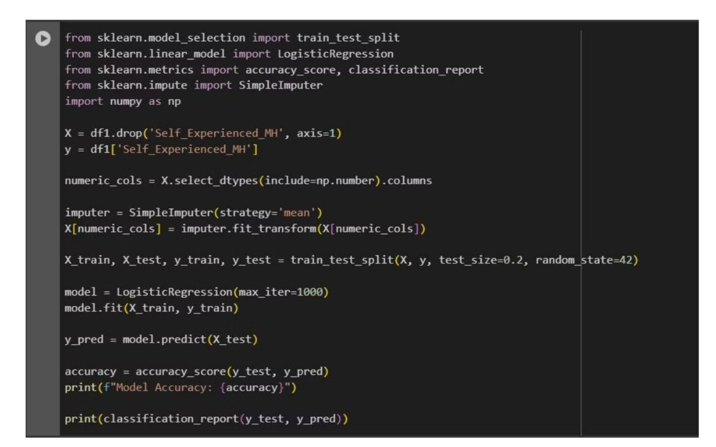
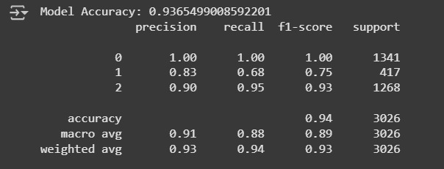
Predictive Modeling: Logistic Regression
Logistic Regression was used to predict mental health outcomes based on various factors.
Why Logistic Regression?
Ideal for predicting binary outcomes (e.g., presence/absence of mental health issues).
Analyzes variables like stress levels, sleep hours, and therapy sessions.
Classifies individuals based on symptoms and risk factors.
Model accuracy
Model Accuracy: 0.9365

Slide 12
Overall Interpretations
1
2
Gender & Education
Employment & Social Media
Both males and females, and those with moderate to high education, are more likely to report mental health issues.
Unemployed individuals and frequent social media users report more mental health issues.
3
4
Age & Income
Awareness
Higher age and lower income are commonly associated with mental health issues.
Lack of awareness ("Don't Know") is more common in younger and middle-income individuals.

Slide 13
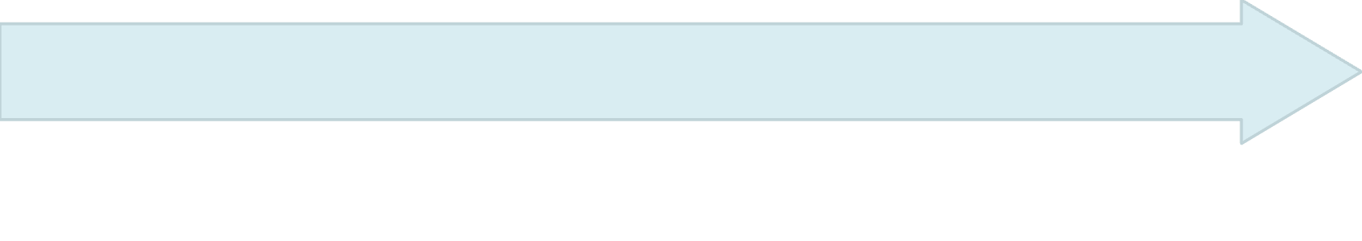
Conclusions & Recommendations
Public Perception of Science
Rising Importance
Disconnect between importance and confidence in science's ability to solve mental health issues.
92% believe mental health is as important as physical health, a significant global shift.
Challenge for Science
Diverse Approach Needed
Build on what works, investigate all possible solutions, and find next-generation treatments.
Acknowledge and investigate a wide range of solutions, not just traditional treatments.

Slide 14

Thank You!
Thank you for your attention and engagement in this crucial discussion on mental health. Your commitment to understanding these insights is invaluable.

